Slide 1


Starvation
Mayank Yadav
U94319493
Practical Cybersecurity

Slide 2
What is DHCP
Dynamic Host Configuration Protocol (DHCP) is a client/server protocol that automatically provides an Internet Protocol (IP) host with its IP address and other related configuration information such as the subnet mask and default gateway.

Slide 3


Slide 4

New Player (needs a jersey number to play, does not know who is captain)
Player’s Dressing Room

Slide 5
Ask Everyone - I need a jersey number to play

Slide 6
The Captain Replies – Will Jersey Number 5 be good for this match

Slide 7
Yes, it will be fine

Slide 8
Register the 5 number jersey to New Player

Slide 9
The New Player
New Computer
The Captain
DHCP Server
DHCP Packets
Conversation

Slide 10
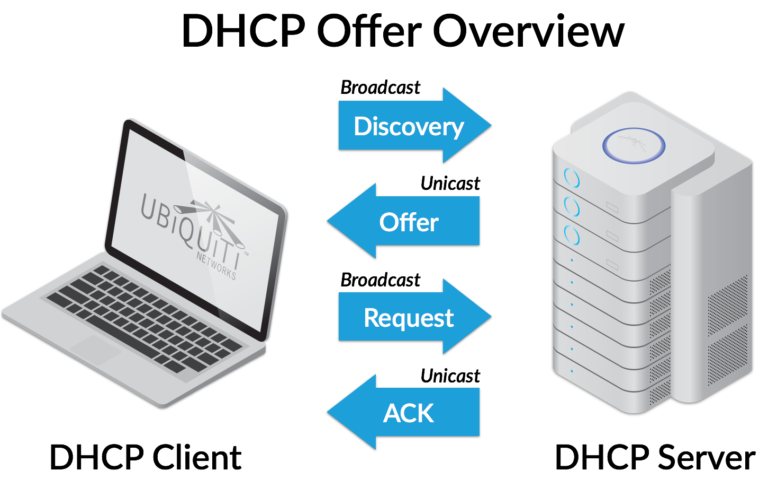

Slide 11
What is DHCP Starvation
A DHCP starvation attack works by broadcasting DHCP requests with spoofed MAC addresses. If enough requests are sent, the network attacker can exhaust the address space available to the DHCP server.

Slide 12

Kali Linux
Terminal -> yersinia –G
Yersinia -> Select DHCP
Click Launch Attack
Click sending Discovering Packet
Click OK
Select Packet and observe MAC address change

Slide 13
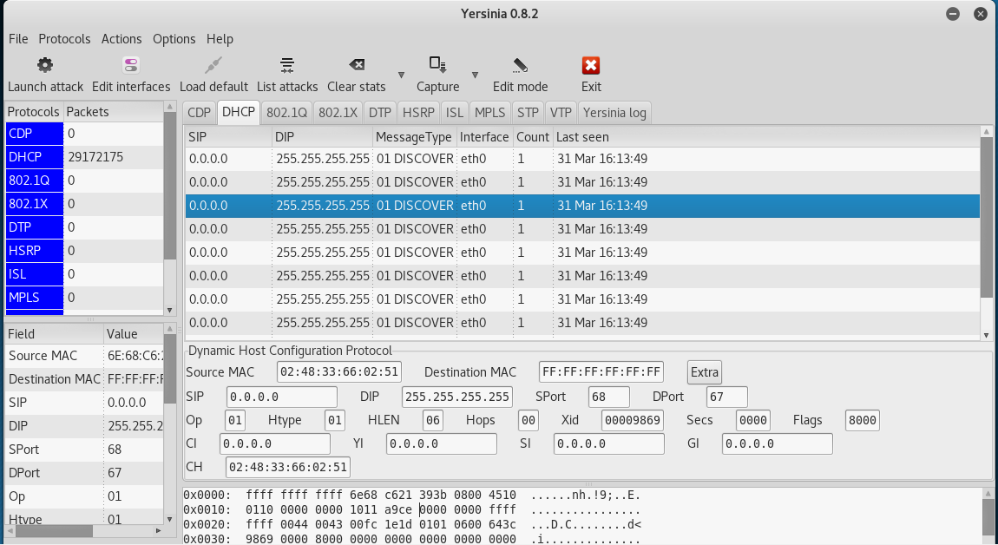

Slide 14
Create a DHCP Server in Virtual Box
We need a Network. With a router or a switch connected to the DHCP Server for this experiment.
But a Cisco router image for virtual box require a contract to be signed
Therefore, an alternative
In Virtual Box, Go to File
Go to Host Network Manager
Go to Create
Enable DHCP Server

Slide 15
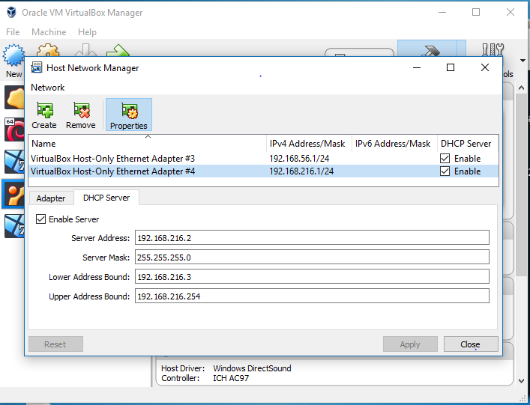

Slide 16
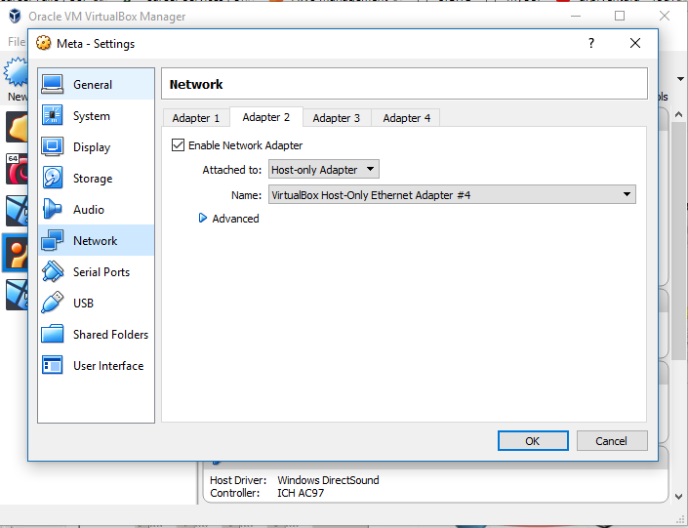
Set The Network
Select the Machine
Select Settings
Select Network
Disable all other network
Create a new network
Select Host-only adapter
Select the New Network Created

Slide 17
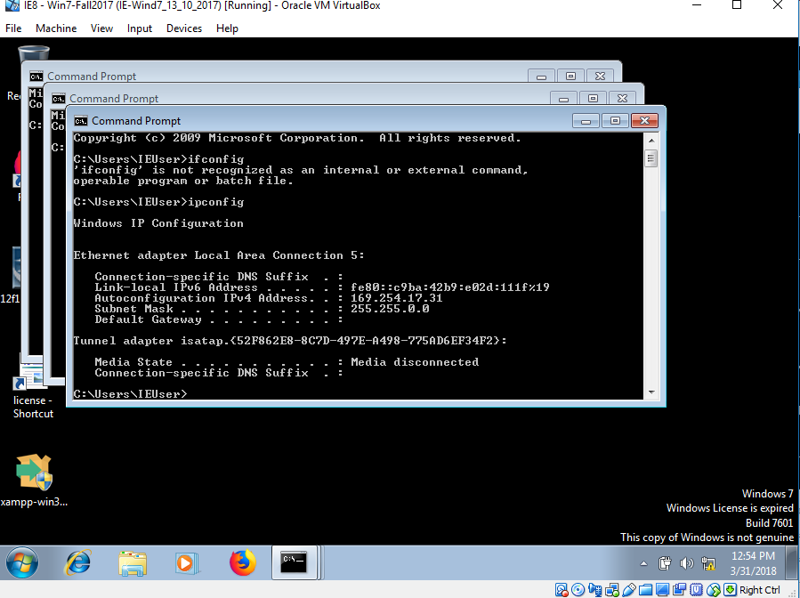
Proof

Slide 18
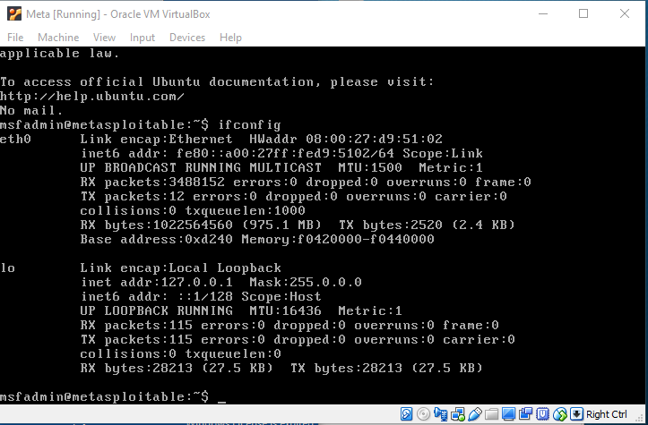
Proof

Slide 19
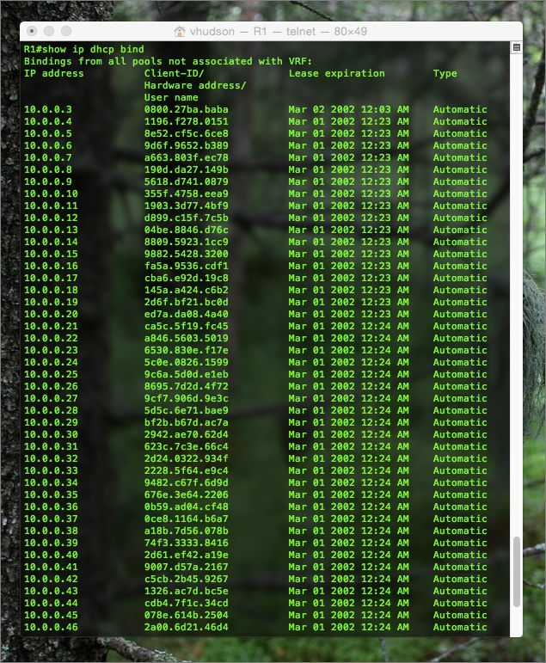
If you have a router

Slide 20
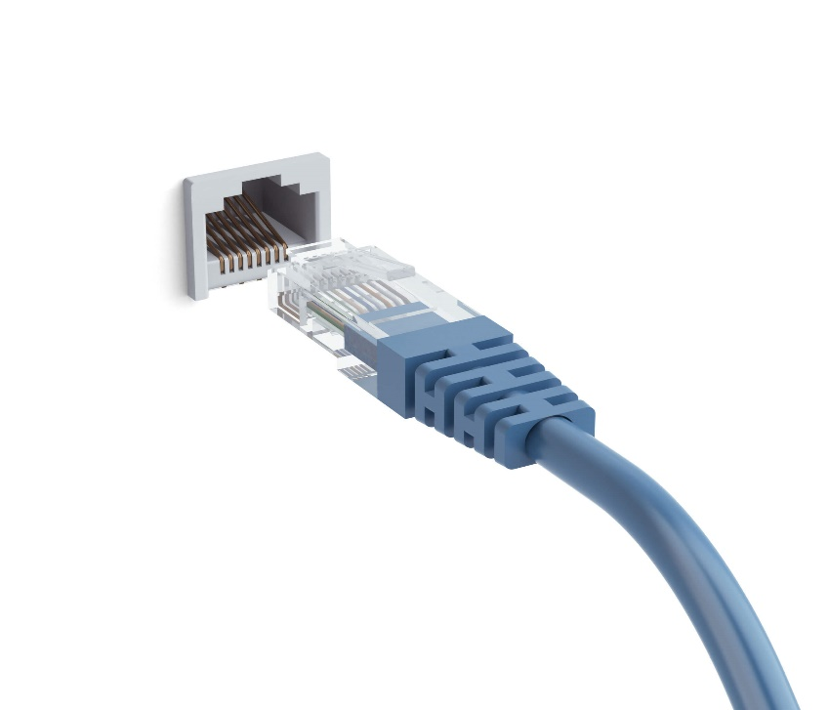
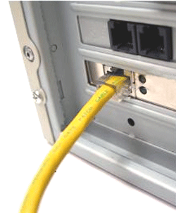
Prevention
swtichport port-security maximum
Just run the above command in router.
But still companies do not use this single line
Let’s understand why
Every Ethernet outlet is assigned to a port in server.
When you connect your machine to the Ethernet, you are assigned the same port.
Note – Compare two DHCP Wireshark packets, observe the port number

Slide 21
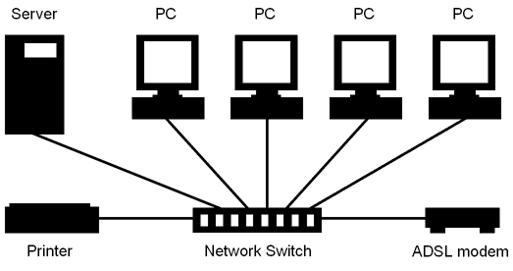
The DHCP is sent using that assigned port only, if the server gets two MAC from same port, it can block using the switch port command. But suppose and this happens in most of the cases, one machine leaves the Ethernet outlet and another machine then connected to that Ethernet outlet. The server will block that port. In this case you have to contact the IT department and file a request. And there will be serval cases like this, therefore the port security command is not used.

Slide 22


